Slide 1
Techno-Economic Analysis of Decarbonization by Electrification of Recycle Processes for High-Purity Isopropanol Recovery
Yi-Xin Lo¹, San-Jang Wang²，David Shan Hill Wong^{1*}
¹ Department of Chemical Engineering, National Tsing Hua University, Hsinchu, Taiwan

Slide 2
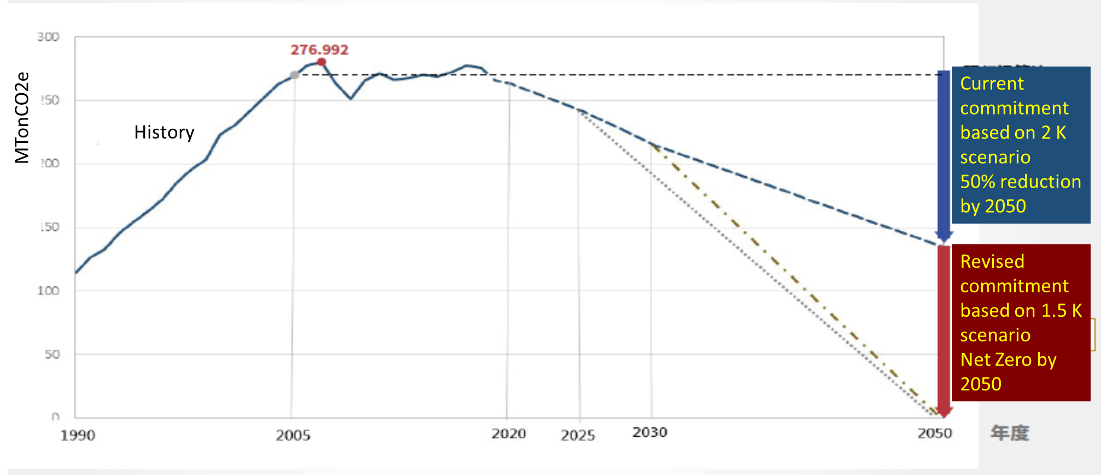
Taiwan’s Long Term Decarbonization Roadmap
Actual emission 2022: 277 MT CO2e
https://www.ndc.gov.tw/Content_List.aspx?n=FD76ECBAE77D9811&upn=D34BDBBBF9103806
Notes:
This is our government plan for march towards the zero emission target.
The original commitment is 50% reduction by 2050 is revised to Net Zero.
The short term target calls 50 MT reduction by 2030.
The latest data of 2022 showed no reduction at all.
Please be reminded that I am not making any judgement on the planning.
Part of responsibility of failure has to be laid on us, the practicing community.

Slide 4
Methods of Decarbonization
Present-to-2030
Phase out old equipment
Intelligent operation
Fuel switching from coal to natural gas/hydrogen
2030-to-2050
Integration of renewable power
Revamping of utility system
Limited reduction of CO2e
Deep decarbonization
How should process adapt?
Notes:
Our government plan actually comes with a working plan for our chemical industry.
Deep decarbonization is achieved by Integration of renewable power and revamping of utility system

Slide 5
Heat Based vs Electricity Based Process
A great portion of current process energy demand is in the form of steam, generated by a fossil fuel based utility system
In the future, a great portion of energy is in the form renewable electricity from renewable energy based grid, or utility system.
Grid
Electricity supply
Low Carbon Grid
Electricity supply
Coal
Natural Gas
Fuel Oil
…
Carbon based Utility System
Production Process
Renewable Electricity
RE based Utility System
Production Process
Steam supply
Steam supply
It is unreasonable, thermodynamically, to convert electricity back into heat. Increasing direct electricity use in a process system, is imperative.
Notes:
A great portion of current process energy demand is in the form of steam, generated by a fossil fuel based utility system
In the future, a great portion of energy is in the form renewable electricity from renewable energy based grid, or utility system.
It is unreasonable, thermodynamically, to convert electricity back into heat. Increasing direct electricity use in a process system, is imperative.

Slide 6
Energy Consumption of Separation Process and Distillation
Separation is a nonspontaneous process, work is required.
Sholl and Lively 2016 reported separation processes consumed nearly 16% percent of total US energy consumption.
Distillation is the workhorse separation process and consumes about half of all energy consumed by separation processes.
How should distillation switched from a thermal-driven to a electric-driven process and what is the cost?
Sholl, D. S., & Lively, R. P. (2016). Seven chemical separations to change the world. Nature, 532(7600), 435-437.
Notes:
Separation is a nonspontaneous process, work is required.
Sholl and Lively 2016 reported separation processes consumed nearly 16% percent of total US energy consumption.
Distillation is the workhorse separation process and consumes about half of all energy consumed by separation processes.
How should distillation switched from a thermal-driven to a electric-driven process and what is the cost?

Slide 7
Motivation, Scope and Objective
High purity isoproanol IPA (IPA, >99.97%) is a feedstock for electronic grade IPA, which is an important solvent for semiconductor manufacturing.
High purity IPA recovery from (IPA, >99.97%) from spent IPA (~15%) is an important part of circular economy for semiconductor manufacturing industry.
The processes have been studied well in the literature, but they are all energy intensive.
Decarbonization of three high purity IPA recovery processes by electrification will be presented in this study.
The goal is to demonstrate the economic potential of this pathway to net zero

Slide 8
Methods of Electrification
Electric Furnace/Boiler (EF/EB)
Heat-pump assisted distillation (HPAD)
Mechanical Vapor Recompression (MVR)
Bottom Vapor Flash Compression (FVC)
Organic Rankine Cycle (ORC)
Steam Generation Heat Pump (SGHP)
MVR+EB, SGHP will be used in this work

Slide 9
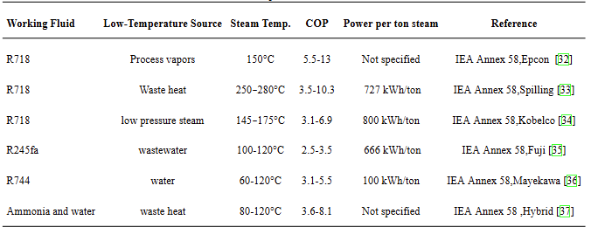
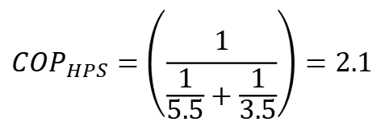
Steam Generaltion Heat Pump
TRL>9
COP of generating low pressure steam from process vapors ranges from 5.5~13.3, we adopt the low estimate of 5.5
COP of generating high pressure steam ranges from waste heat3.5~10.3, we adopt the low estimate of 3.5
COP of generating high pressure steam from process vapors is esimated to be 2.1
$${COP}_{HPS}=\left(\frac{1}{\frac{1}{5.5}+\frac{1}{3.5}}\right)=2.1$$
Klute et al, Steam generating heatpumps-overview,classification,economics,and basic modeling principles.Energy Conversionand Management,299:117882,202
Notes:
The table lists a variety of SGHP working fluids and their application conditions, and indicates the COP values and steam temperature ranges of different systems. For example, EPCON's MVR heat pump used in this study has a COP of about 5.5 for low to medium temperature (<150°C) applications, while the Spilling steam compressor raises the steam temperature to 250°C with a COP of about 3.5, and steam generation above 250°C requires a series cascade of two SGHPs, with a combined COP of about 2.1.

Slide 10
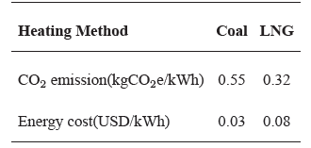
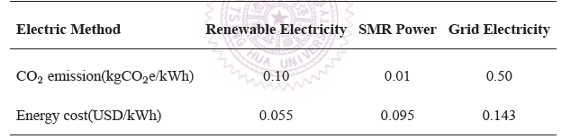
Technoeconomic Data
Data compiled from Taipower, Energy Bureau, Ministry of Economics, IEA, IRENA, IPCC and other open source literature
Notes:
Calculations for each energy source are as follows: (a) Heat production cost and emissions from coal: based on imported thermal coal at US$120/ton, with a heat value of about 7,000 kWh/ton, and after correcting for the boiler efficiency, the unit price of heat is about US$0.03/kWh, and the carbon dioxide emissions are about 0.55 kgCO2/kWh. (b) Heat production cost and emissions from liquefied natural gas (LNG): the price of LNG is about US$14/MMBtu, which translates into a unit price of heat of about US$0.08/kWh and carbon dioxide emissions of about 0.32 kgCO$_2$/kWh. MMBtu, converted heat unit price about US$0.08/kWh, and CO2 emissions about 0.32 kgCO$_2$/kWh.(iii) Renewable electricity (wind): electricity price about US$0.055/kWh, and lifecycle emissions about 0.10 kgCO2e/kWh.(iv) Small Module Nuclear Energy (SMR) (d) Small Module Nuclear (SMR): electricity price about US$0.095/kWh, life cycle emission about 0.01 kgCO2e/kWh.(e) Taiwan Grid Power: industrial electricity price about US$0.143/kWh, average carbon emission factor about 0.50 kgCO2e/kWh. The above data are summarized in the table to provide a basic basis for the analysis of the cost of energy and the carbon emission in the future.

Slide 11
Azeotropic Distillation Using Cycohexane
Wang, C. J., Wong, D. S. H., Chien, I. L., Shih, R. F., Liu, W. T., & Tsai, C. S. (1998). Critical reflux, parametric sensitivity, and hysteresis in azeotropic distillation of isopropyl alcohol+ water+ cyclohexane. Industrial & engineering chemistry research, 37(7), 2835-2843.
Chien, I. L., Wang, C. J., Wong, D. S. H., Lee, C. H., Cheng, S. H., Shih, R. F., ... & Tsai, C. S. (2000). Experimental investigation of conventional control strategies for a heterogeneous azeotropic distillation column. Journal of Process Control, 10(4), 333-340.
Shi, L., Huang, K., Wang, S. J., Yu, J., Yuan, Y., Chen, H., & Wong, D. S. (2015). Application of vapor recompression to heterogeneous azeotropic dividing-wall distillation columns. Industrial & Engineering Chemistry Research, 54(46), 11592-11609.
Notes:
本研究採用三塔共沸蒸餾系統，以環己烷（Cyclohexane，CYH）作為共沸劑進行高純度異丙醇（IPA）之回收。操作條件依據Wang等人（2014）所提出之優化設計進行模擬，以期提升分離效率與能耗表現，作為高純度IPA製程之技術參考。

Slide 12
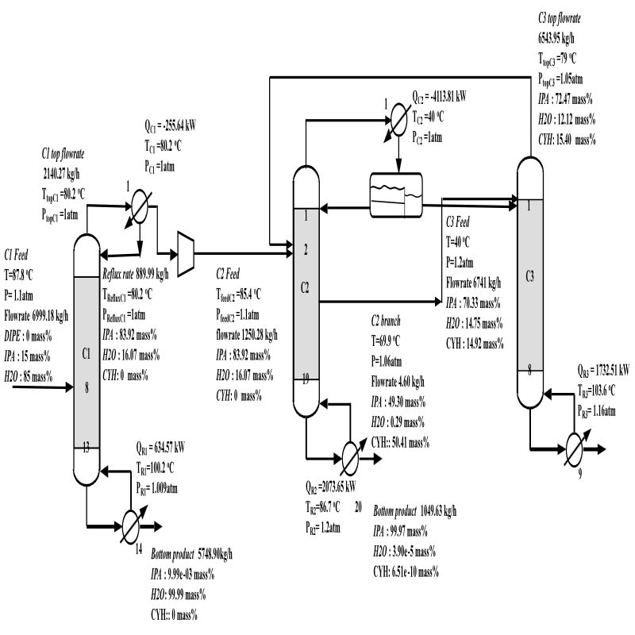
Basic Three Column Process
Notes:
In this study, th steady state simulation of a three-column azeotropic distillation system (CyH_AD) was carried out using Aspen Plus V12.1, and the process configuration is shown in the figure. The feed was a 15 wt% isopropyl alcohol (IPA) solution in circulating water with a flow rate of 7 tons per hour. The feed first enters the preconcentration column (C1) to increase the concentration of IPA, and then flows into the azeotropic column (C2), where cyclohexane (CYH) is added as an azeotropic agent to form a ternary lowest boiling point azeotropic mixture of water, IPA and CYH. After condensation, the vapor at the top of the tower is separated into CYH-rich phase and water-rich IPA phase, where the CYH-rich phase is refluxed to replenish the azeotropic agent, and the water-rich IPA phase is sent to the dewatering column (C3) for further drying.The product at the bottom of the C2 tower reaches a purity of 99.97 wt% of IPA, w

Slide 13
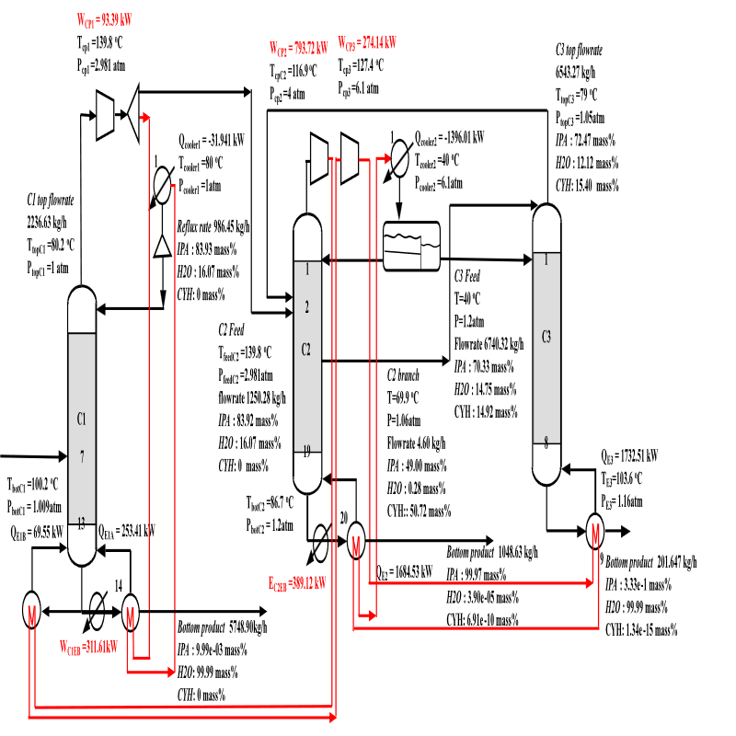
HPAD Design
Notes:
The heat pump-assisted three-column azeotropic distillation (HPAD) system is based on the principle of mechanical vapor recompression (MVR), which is based on the compression of steam at the top of the distillation columns and the recovery of its latent heat of condensation to supply the reboiler load to form a closed-loop, self-feeding heat pump cycle in each distillation column. The complete flow of the system is shown in the figure. The system integrates two independent heat pump circuits. C1 tower top vapor is compressed by single-stage isentropic compression, the pressure is raised from 1 atm to 2.981 atm, part of which is supplied to C2 tower, and the rest is completely condensed at 2.981 atm and 110°C, and the latent heat of condensation is supplied to the C1 reboiler directly to form a closed-loop heat recovery. C2 tower top vapor is compressed to 6.1 atm, and condensed at 114°C, the released heat energy can also satisfy the load of each distillation tower. The heat released meets the demand of both C2 and C3 reboilers. Due to the compression ratio of 6.1, the compression process is divided into two stages in consideration of thermal efficiency and mechanical constraints. An intercooler is provided between the two stages to partially condense the superheated vapor at 111°C, effectively recovering the sensible heat and supplying it to the C1 reboiler. Since the recovered heat from vapor recompression is not enough to fully supply the heat load of C1 and C2, auxiliary electric boilers (EB1 and EB2) are installed at the bottom of the two towers to supplement the heat energy.

Slide 14
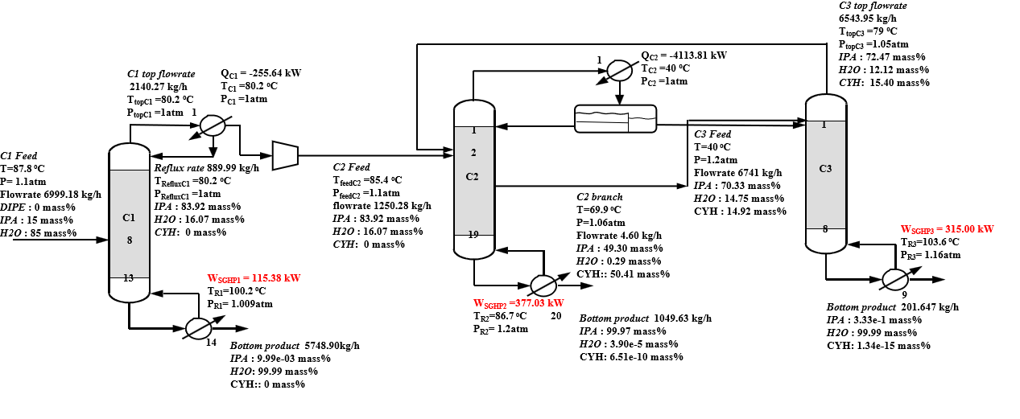
SGHP Processs (COP=5.5)
Notes:
The temperature of the tower bottom is below 150c, so the centralized heat supply is provided by a steam heat pump system (SGHP) with a COP of 5.5. The system converts the original heat load of about 1,892 kW into an electrical power input of 344 kW, which significantly improves energy efficiency. A schematic diagram of the system flow is shown in the figure.

Slide 15
Economic Analysis
Carbon abatement cost is calculated with reference to conventional process with coal as fuel
 | Conventional |  | HPAD+EB |  |  | SGHP
Energy Type | Coal | LNG | Wind | SMR | GRID | Wind | SMR | GRID
Energy [kW] | 4441(Q) |  | 1862(W) |  |  | 807(W)
Energy Cost [USD/h] | 133 | 355 | 102 | 177 | 266 | 44 | 77 | 115
CO2e[kg/h] | 2443 | 1421 | 186 | 19 | 931 | 81 | 8 | 404
Caron Abatement Cost [USD/tonCO2] | -- | 217 | -14 | 18 | 88 | -38 | -23 | -9
Notes:
In this slide, the economic benefits and costs of the conventional three-column azeotropic distillation, a heat pump-assisted distillation coupled with an assisted electric boiler system (HPAD+EB), and a steam-generated heat pump (SGHP) system with a COP of 5.5 are compared. The CAC is calculated to is calculated with reference to conventional process with coal as fuel

Slide 16
Azeotropic Distillation using Di-isopropyl Ether (DIPE)
Qi, J., Tang, J., Zhang, Q., Wang, Y., Chen, H., Zhao, H., & Zhang, L. (2019). Heat-integrated azeotropic distillation and extractive distillation for the separation of heterogeneous ternary azeotropes of diisopropyl ether/isopropyl alcohol/water. Industrial & Engineering Chemistry Research, 58(45), 20734-20745.
Notes:
本節介紹以二異丙醚（DIPE）作為共沸劑之共沸蒸餾過程電氣化研究。透過模擬分析探討DIPE輔助共沸蒸餾系統在異丙醇純化製程中的應用潛力與能源效益，旨在評估其在推動製程電氣化與節能減碳方面的可行性及優勢。

Slide 17
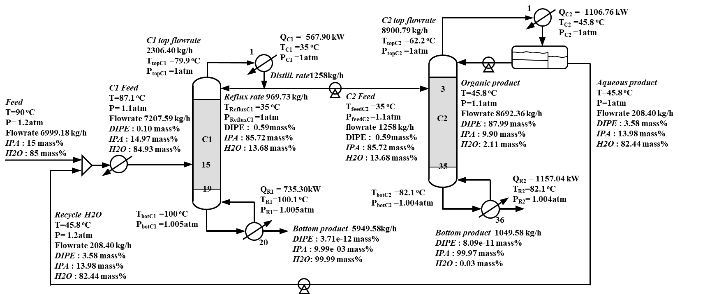
Two-Column Process
Notes:
A two column process was simulated. The total condenser duty was found to be 1675 kW and the total reboiler duty was found to be 1894 kW.

Slide 18
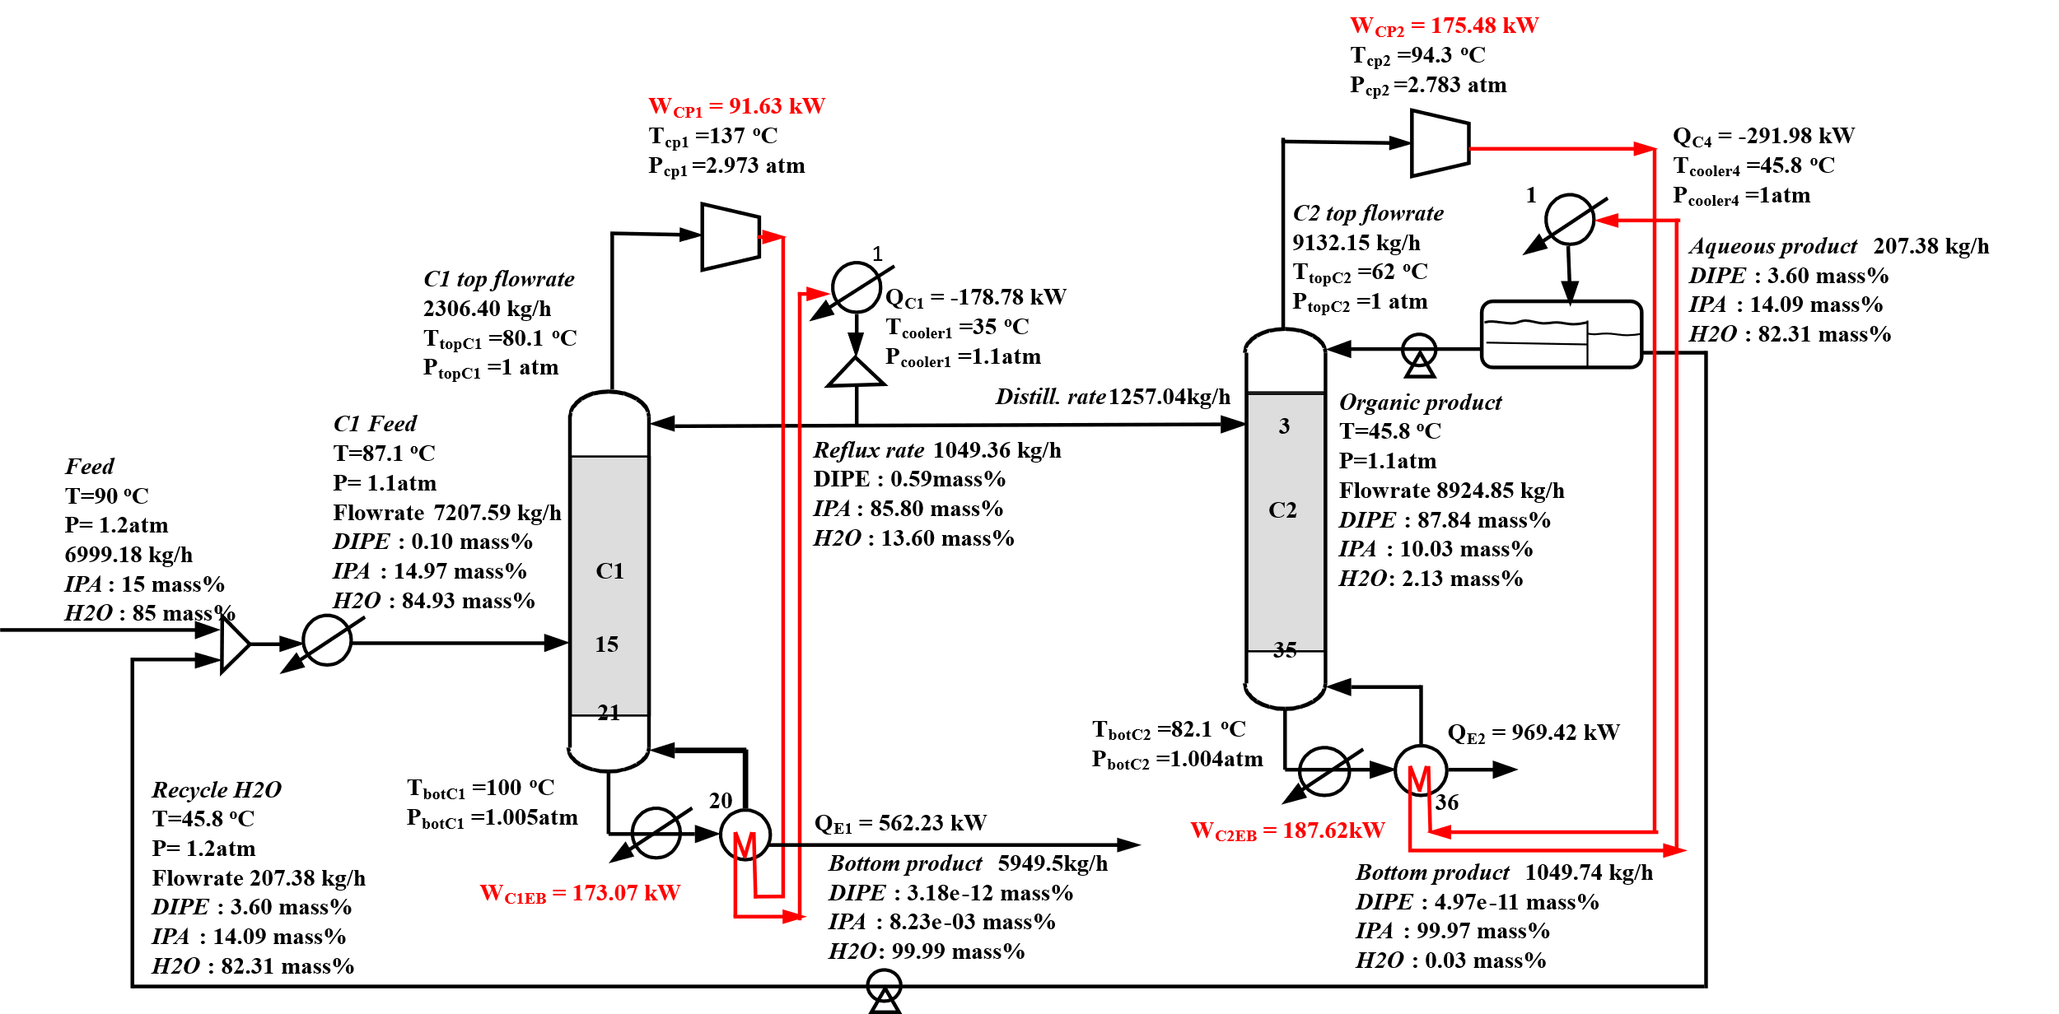
HPAD Process
Notes:
In HPAD the total work required is reduced to 268 kW, yet two electric reboilers of 360 kW are required

Slide 19
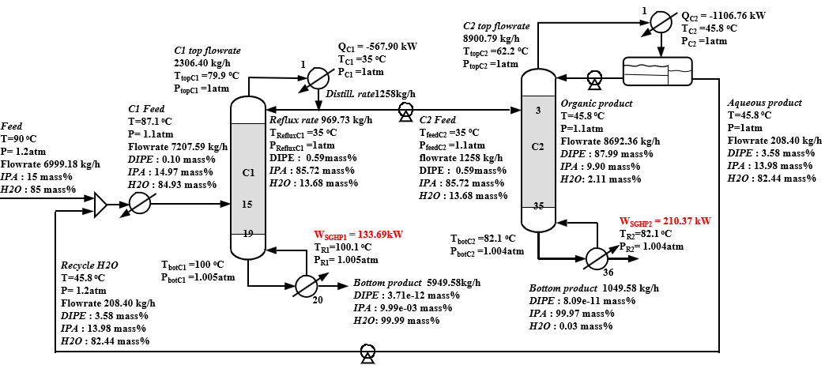
SGHP Process (COP=5.5)
Notes:
The work of SGHPs were computed using a COP 5.5

Slide 20
Economic Analysis
Carbon abatement cost is calculated with reference to conventional process with coal as fuel
 | Conventional |  | HPAD+EB |  |  | SGHP
Energy Type | Coal | LNG | Wind | SMR | GRID | Wind | SMR | GRID
Energy [kW] | 1892(Q) |  | 628(W) |  |  | 544(W)
Energy Cost [USD/h] | 57 | 151 | 35 | 60 | 90 | 19 | 33 | 49
CO2e[kg/h] | 1041 | 605 | 63 | 6 | 314 | 34 | 3 | 172
Caron Abatement Cost [USD/tonCO2] | -- | 216 | -22 | 3 | 45 | -38 | -23 | -9
Notes:
In this slide, the economic benefits and costs of the conventional three-column azeotropic distillation, a heat pump-assisted distillation coupled with an assisted electric boiler system (HPAD+EB), and a steam-generated heat pump (SGHP) system with a COP of 5.5 are compared. The CAC is calculated to is calculated with reference to conventional process with coal as fuel

Slide 21
Extractive Distillation Using Dimethyl Sulfoxide
Arifin, S., & Chien, I. L. (2008). Design and control of an isopropyl alcohol dehydration process via extractive distillation using dimethyl sulfoxide as an entrainer. Industrial & engineering chemistry research, 47(3), 790-803.
Liang, K., Li, W., Luo, H., Xia, M., & Xu, C. (2014). Energy-efficient extractive distillation process by combining preconcentration column and entrainer recovery column. Industrial & Engineering Chemistry Research, 53(17), 7121-7131.
Duan, C., & Li, C. (2023). Energy-saving improvement of heat integration for separating dilute azeotropic components in extractive distillation. Energy, 263, 125821.

Slide 22
Without Heat Integration
Notes:
本研究建立一套三柱萃取蒸餾系統，設計依據Liang等人（2014）提出之節能萃取蒸餾流程。

Slide 23
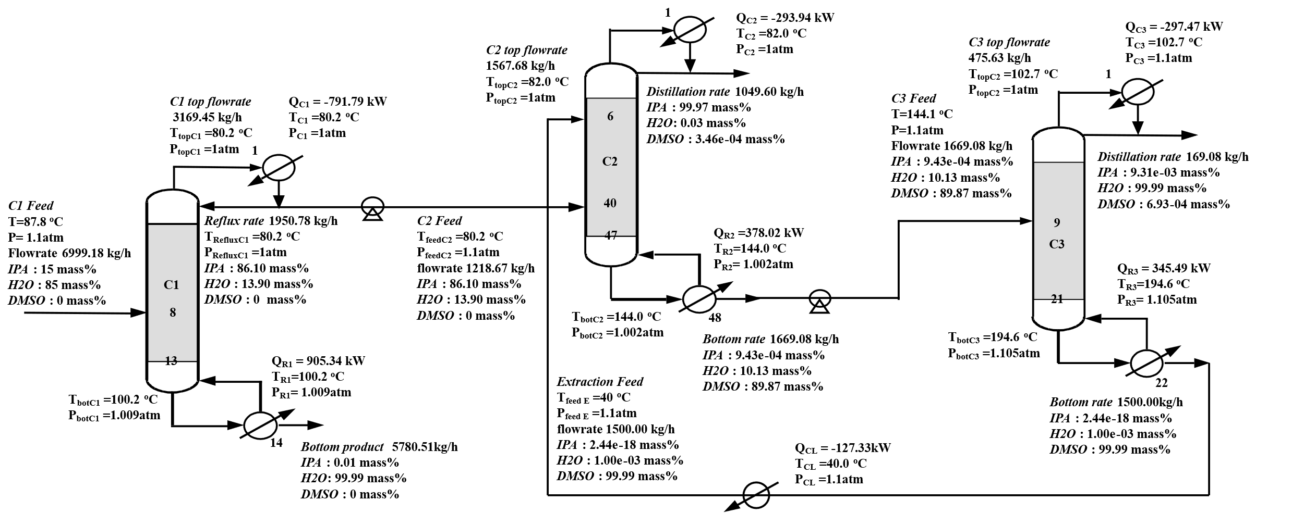
Conventional Process (ED_DMSO)
Notes:
The total condenser duty available is 1383 kW, the total reboiler duty required is 1629 kW, again the duty provided is insufficent

Slide 24
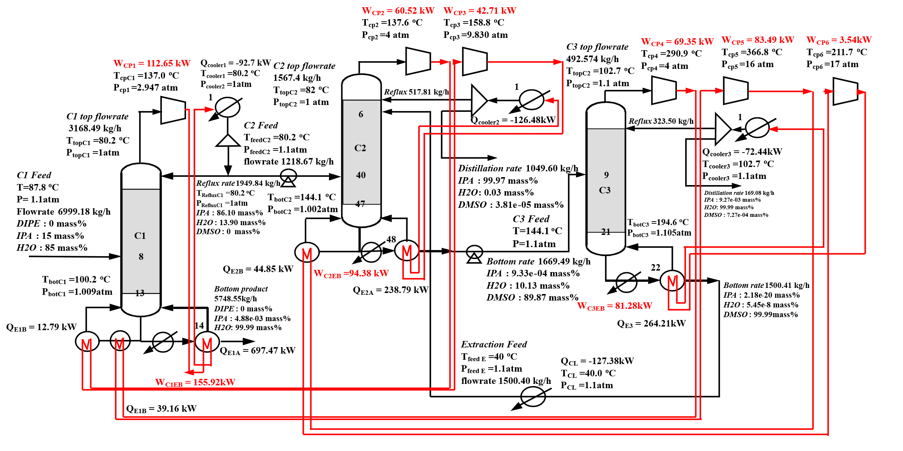
HPAD Design ED_DMSO+HPAD
Notes:
Two electric boilers are required
The total worj required is 113+61+43+69+84+3.5+94+81=708

Slide 25
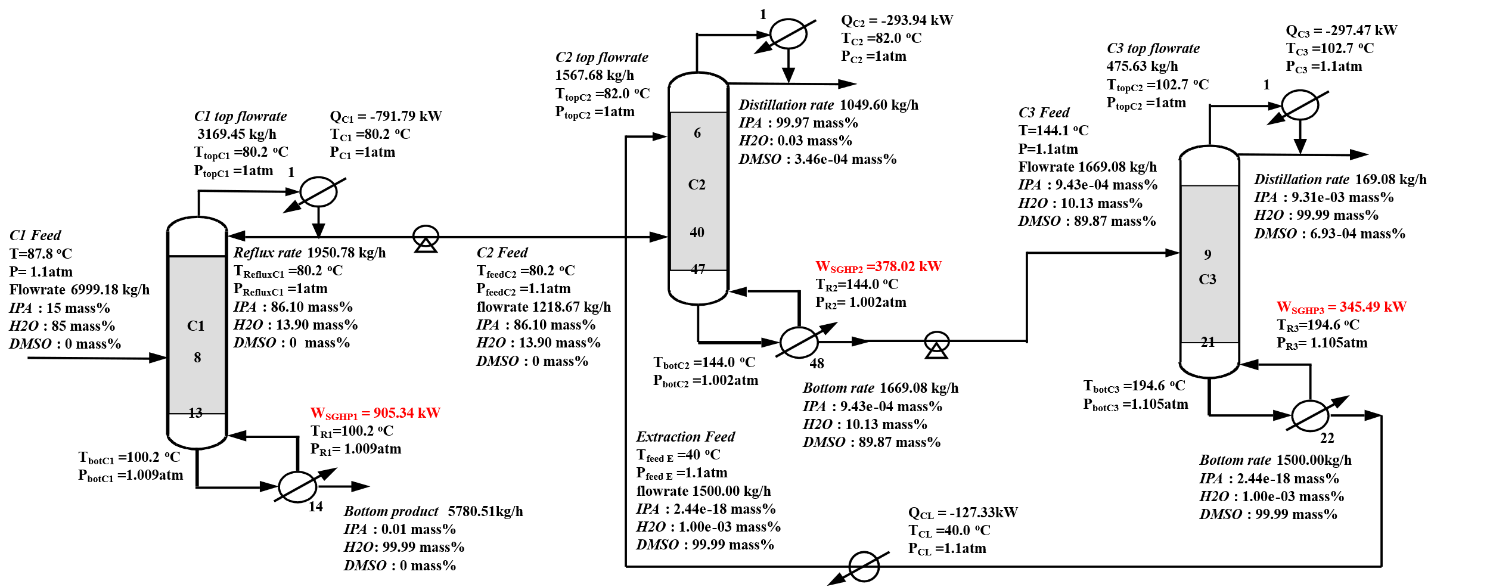
SGHP Process (ED_DMSO+SGHP)
Notes:
本研究中，蒸汽熱泵系統（SGHP）第一座蒸餾柱塔底溫度低於150°C，採用Epcon技術，配備COP為5.5的壓縮機；第二及第三柱則採用Spilling技術，作為製程集中供熱系統，配備COP為2.1的壓縮機。此配置能有效將原始約1629 kW的熱負荷降低至509 kW的電力輸入，顯著提升整體能源利用效率。相關流程示意圖如圖所示。

Slide 26
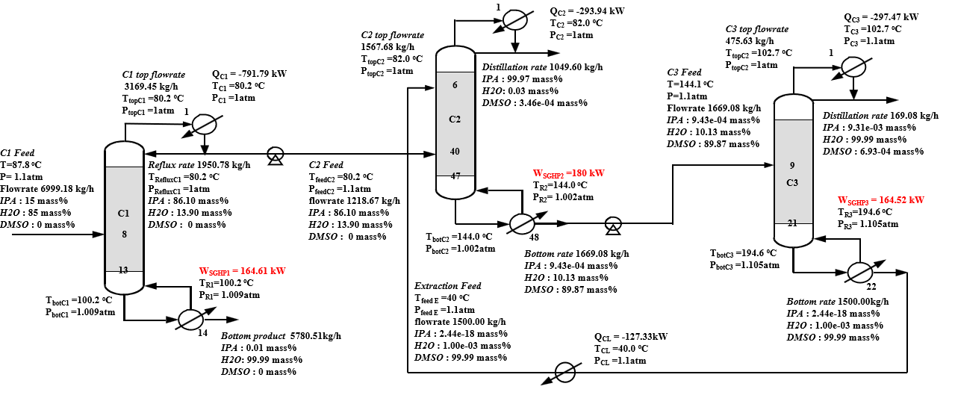
SGHP Process (ED_DMSO+SGHP)

Slide 27
Economic Analysis
Carbon abatement cost is calculated with reference to conventional process with coal as fuel
 | Conventional |  | HPAD+EB |  |  | SGHP
Energy Type | Coal | LNG | Wind | SMR | GRID | Wind | SMR | GRID
Energy [kW] | 1629(Q) |  | 704(W) |  |  | 509(W)
Energy Cost [USD/h] | 49 | 130 | 39 | 67 | 101 | 28 | 48 | 73
CO2e[kg/h] | 886 | 521 | 70 | 7 | 352 | 51 | 5 | 255
Caron Abatement Cost [USD/tonCO2] | -- | 216 | -12 | 20 | 96 | -25 | -1 | 37
Notes:
In this slide, the economic benefits and costs of the conventional three-column azeotropic distillation, a heat pump-assisted distillation coupled with an assisted electric boiler system (HPAD+EB), and a steam-generated heat pump (SGHP) system with a COP of 5.5 are compared. The CAC is calculated to is calculated with reference to conventional process with coal as fuel

Slide 28
Heat Integration
Notes:
本研究針對傳統三柱萃取蒸餾系統（DMSO_ED）高能耗問題，引入熱能整合策略以提升能源利用效率並降低外部蒸汽需求。該整合配置基於Duan與Li（2023）所提出之節能方法，相關流程示意如圖所示。

Slide 29
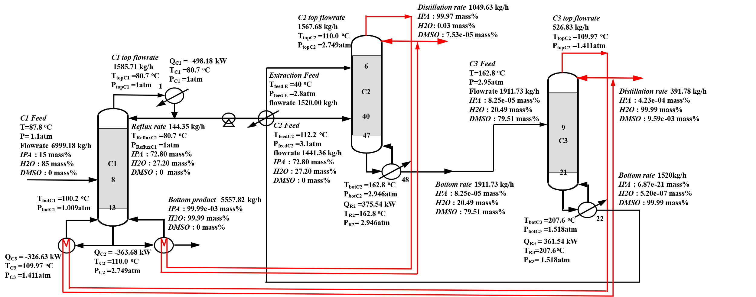
Conventional Process (DMSO_ED+HI)
Notes:
相關流程示意如圖所示。操作條件及整合機制說明如下：預濃縮柱（C1）於大氣壓（1 atm）下運行，其再沸器熱能完全由C2及C3塔頂冷凝器釋放之潛熱供應。萃取蒸餾柱（C2）則於增壓條件下運作，提升塔頂蒸氣冷凝溫度，使其能作為C1之熱源。C2進料來自C1，而DMSO萃取劑由溶劑回收柱（C3）回收再利用。C3亦在增壓狀態運轉，其塔頂潛熱回收用於供應C1再沸器，並利用高溫再生DMSO塔底液對C2進料進行預熱，實現顯熱回收。此熱能整合策略有效提升系統整體熱能利用率，達成節能目標。

Slide 30
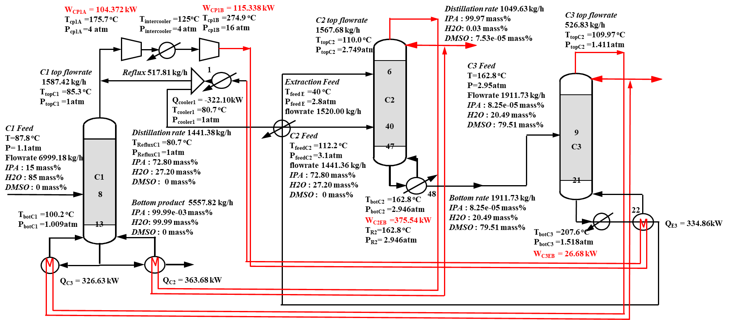
HPAD Design (ED_DMSO_HI+HPAD)
Notes:
本研究所應用之熱泵輔助三柱萃取蒸餾系統（HPAD）配置如圖所示。系統中，C1塔頂蒸氣經兩級等熵壓縮，壓力由1 atm提升至16 atm。壓縮後之過熱蒸氣溫度達275°C，隨後於冷凝器被冷凝至218°C，確保冷凝器出口蒸氣分率為零。凝結放熱直接作為C3再沸器之主要熱源。
在此配置中，C2及C3維持原有熱整合操作模式，利用C2與C3塔頂冷凝器釋放之潛熱及C3高溫塔底液釋放之顯熱，分別供應C1再沸器與C2進料預熱，形成多段熱交換及能量梯級利用機制。

Slide 31
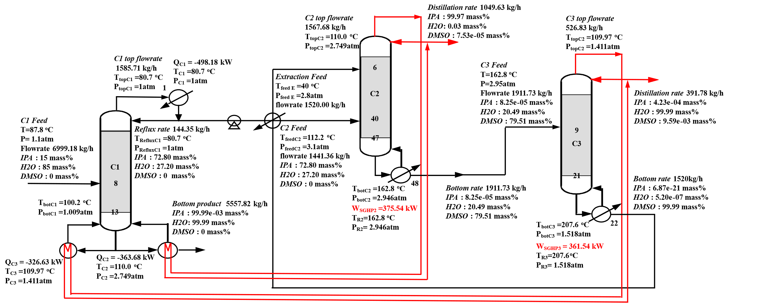
SGHP Process (ED_DMSO_HI+SGHP)
COP=5.5 for C1
COP=2.1 for C2&C3

Slide 32
Economic Analysis
Carbon abatement cost is calculated with reference to conventional process with coal as fuel
 | Conventional |  | HPAD+EB |  |  | SGHP
Energy Type | Coal | LNG | Wind | SMR | GRID | Wind | SMR | GRID
Energy [kW] | 737(Q) |  | 622(W) |  |  | 351(W)
Energy Cost [USD/h] | 22 | 59 | 34 | 59 | 89 | 19 | 33 | 50
CO2e[kg/h] | 405 | 236 | 62 | 2 | 311 | 35 | 4 | 176
Caron Abatement Cost [USD/tonCO2] | -- | 216 | 35 | 93 | 713 | -8 | 27 | 122

Slide 33
Conclusions
Notes:
基線狀況下，四種製程總能耗分別為1892、4441、1629及737 kW，反映其基本操作需求。導入HPAD後，能耗顯著下降至661、1827、669及636 kW，顯示HPAD於中高溫蒸餾製程之節能效果。假設SGHP系統COP分別為5.5與2.1，能耗進一步降低至344、807、509及351 kW，展現卓越熱整合性能與最佳整體能效及碳排放減量潛力。經濟與碳排分析顯示，以煤炭燃燒作為基準，台灣現行電網電力雖具操作便利性，惟碳強度偏高，限制減碳成效。例如，流程一HPAD系統以電網電力驅動時，碳排高達331 kg CO2當量/小時，能源成本95美元/小時。相較之下，以再生能源驅動的HPAD系統碳排大幅降低（流程一僅66 kg CO2當量/小時），且碳減排成本約為–22美元/公噸，展現卓越永續性及成本競爭力。在較高操作溫度（如流程三）條件下，SGHP系統保持優異能效。搭配風力電力，碳排進一步降至約51 kg CO2當量/小時，碳減排成本低於傳統燃料加熱（約–25美元/公噸），強調風力作為高溫工業熱源之潛力。HPAD雖具節能潛力，但在高壓縮比條件下（如流程三需三段壓縮達17 atm）效率明顯下降，導致壓縮功率需求增加與碳減排成本提升（電網條件下高達335美元/公噸）。

Slide 34
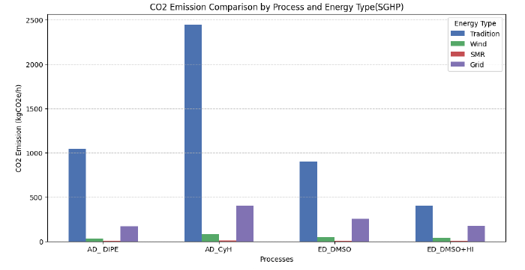
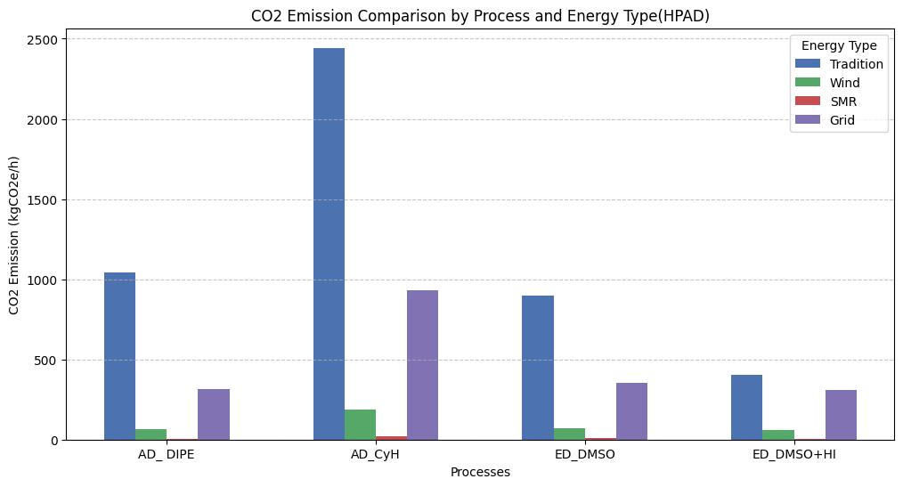
CO2 emission
Deep carbon abatement can be achieved by electrification with SGHP and HPAD

Slide 35
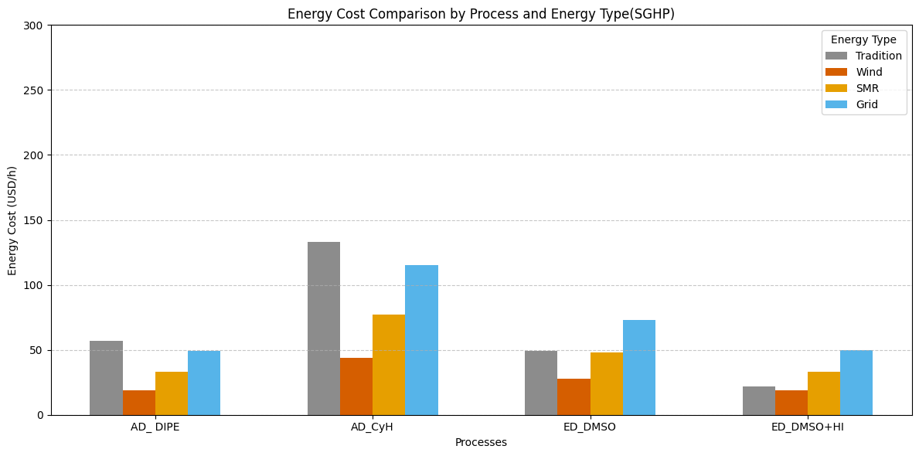
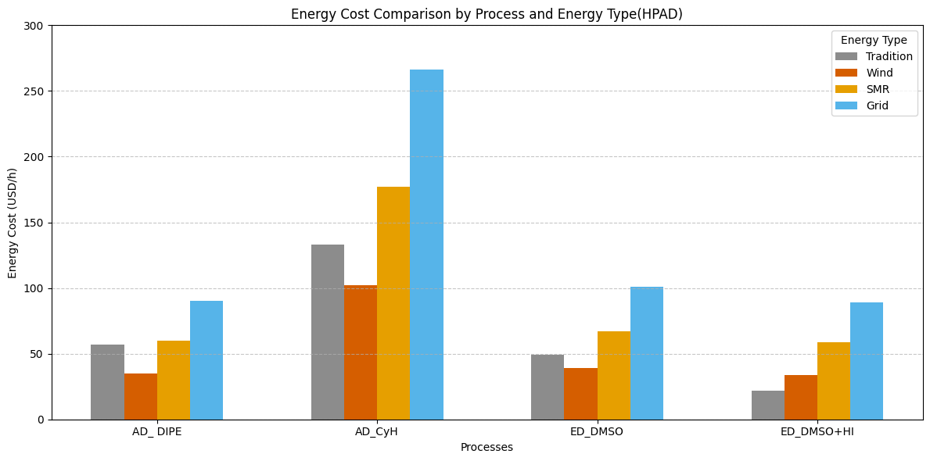
Energy Cost
For SGHP, reduction in energy cost can be achieved regardless of the low carbon energy source except for the ED_DMSO_HI case.
For HPAD, reduction in energy cost can only be achieved by wind power. For ED_DMSO_HI case no reduction is possible.

Slide 36
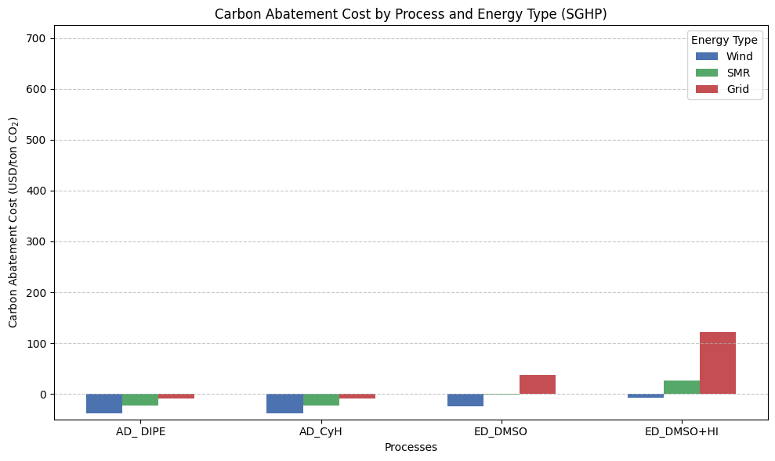
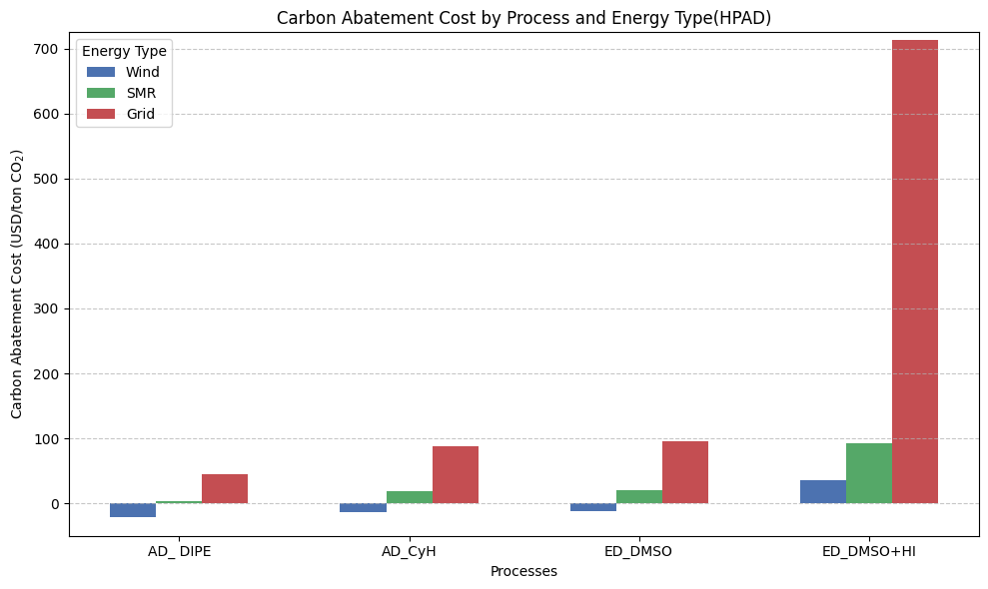
Carbon Abatement Cost
For SGHP, negative carbon abatement costs except for and ED_DMSO using grid power and the ED_DMSO_HI case.
For HPAD, negative carbon abatement costs cost can only be achieved by wind power. For ED_DMSO_HI case the carbon abatement costs are all possible.

Slide 37
Overall Summary
Electrification offers great potential for deep decarbonizaton
It is less costly to fuel switching and carbon capture.
Negative carbon abatement costs, or benefits can achieved in some cases; providing incentives for process industry to start investing in this technology.
SGHP is in generable more flexible than local HPAD, only revamping of the utility system is required.

